Slide 1
The content of this presentation is provided as information only, is the property of Sukhoi Civil Aircraft Company
and shall not be copied or used without written consent from Sukhoi Civil Aircraft Company.

Slide 2
Partnership Structure
100%
Design & production
Certification
Sales & marketing
100%
Customer support
VIP version development
Sales & marketing

Slide 3
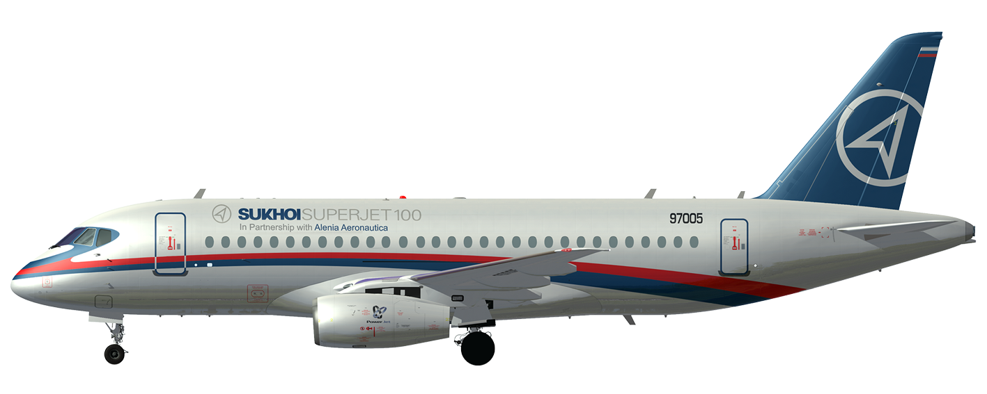
Best-in-Class Suppliers
Avionics
Control system, air conditioning
APU
Fuel system
Powerplant
Hydraulic system
Electric systems
Wheels, brakes
Landing gear

Slide 4
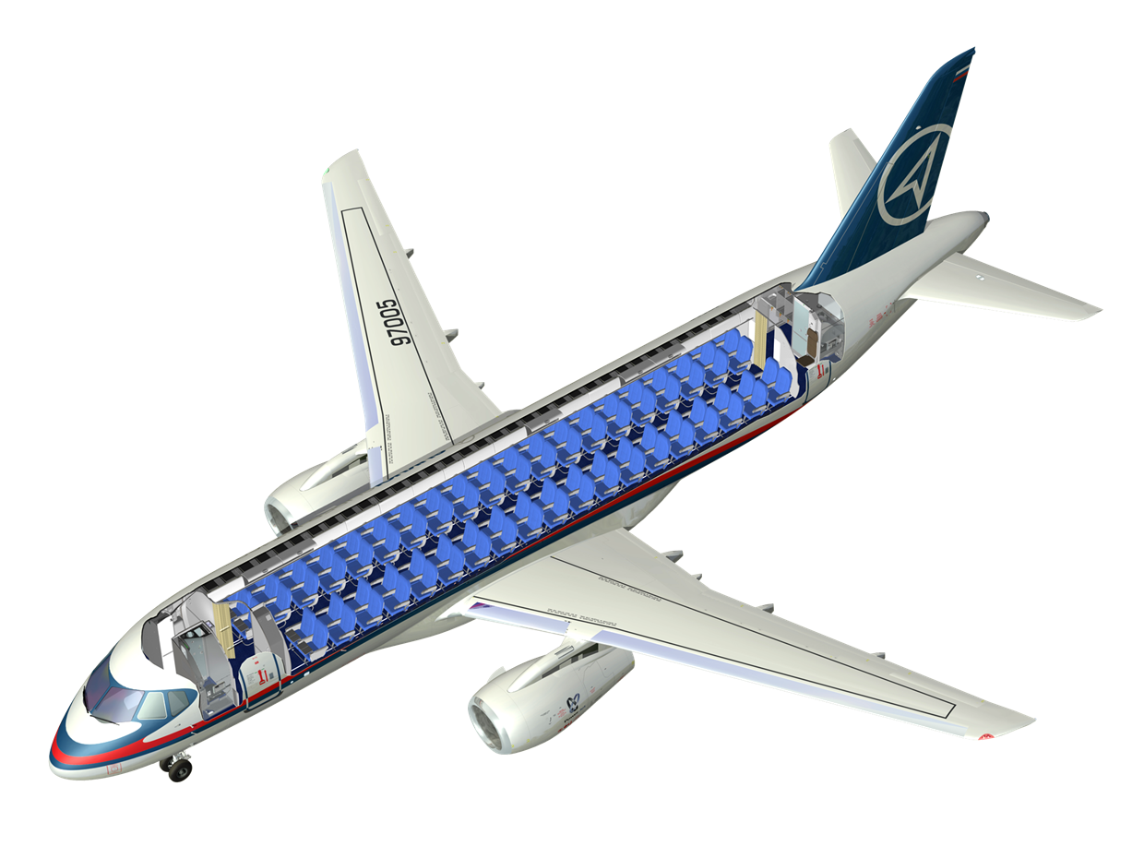
Basic Configuration
98 PAX in full economy class @ 32” pitch
2 galleys
2 lavatories
2 flight attendants
1 wardrobe

Slide 5
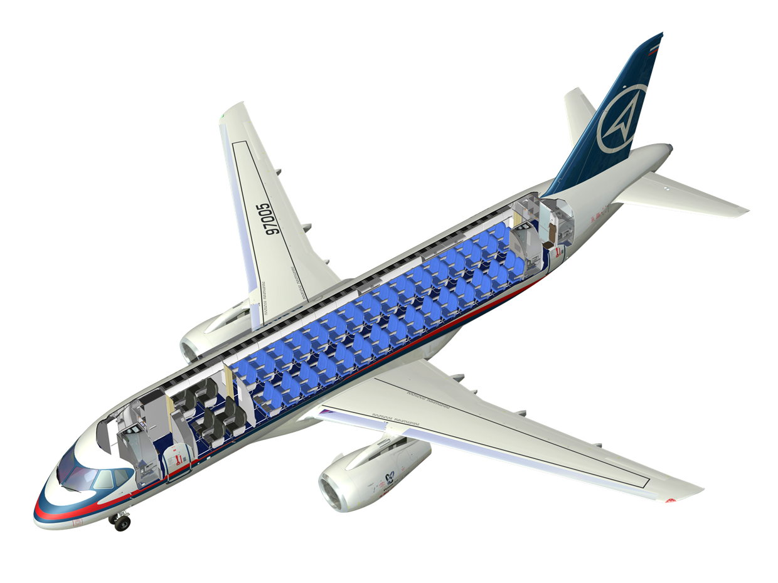
Two-Class Configuration
85 PAX in economy class @ 30” pitch
8 PAX in business class @ 38” pitch
3 galleys
3 lavatories
3 flight attendants
1 wardrobe

Slide 6
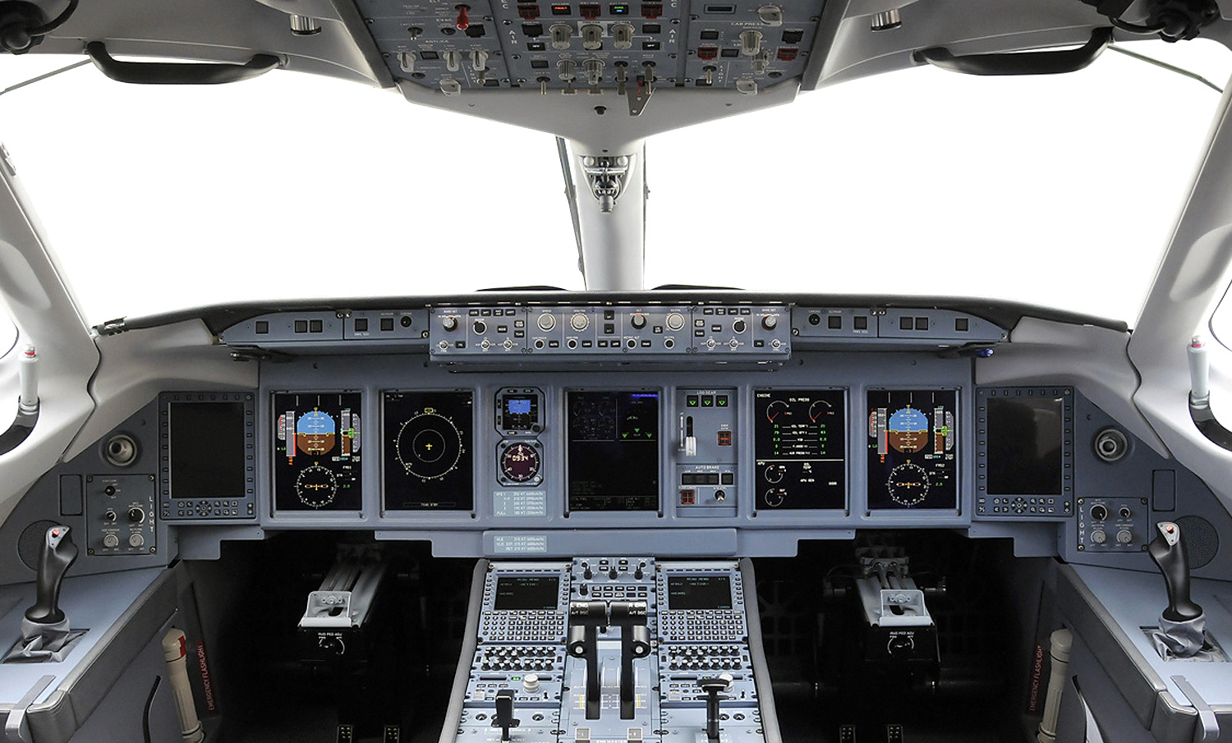
State-of-the-Art Avionics
Side stick controls
A380 IMA technology
Fly-by-Wire
ACARS in base configuration
Electronic flight bags (optional)
The content of this presentation is provided as information only, is the property of Sukhoi Civil Aircraft Company
and shall not be copied or used without written consent from Sukhoi Civil Aircraft Company.

Slide 7
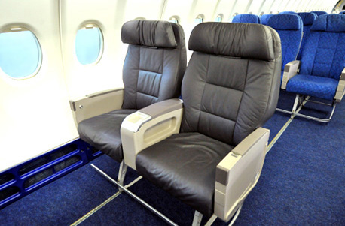
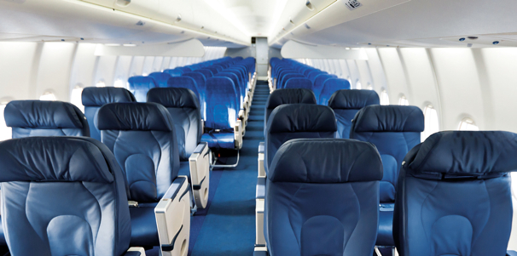
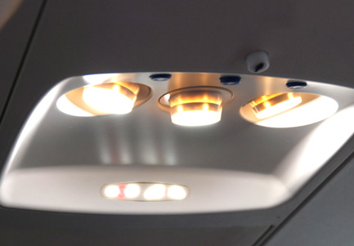
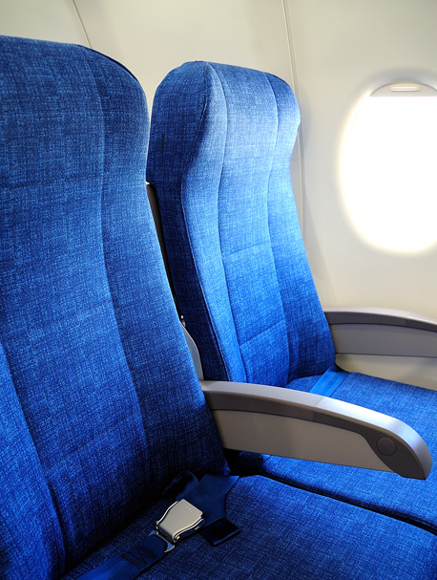
New Standard in Comfort
High and wide cabin
– More space, higher comfort
– Wide aisle
LED lighting
– Lower maintenance
– More reliable than traditional light bulbs
– Dimming and mood lighting possibilities
Bigger bins
– Easier boarding operations
The content of this presentation is provided as information only, is the property of Sukhoi Civil Aircraft Company
and shall not be copied or used without written consent from Sukhoi Civil Aircraft Company.

Slide 8
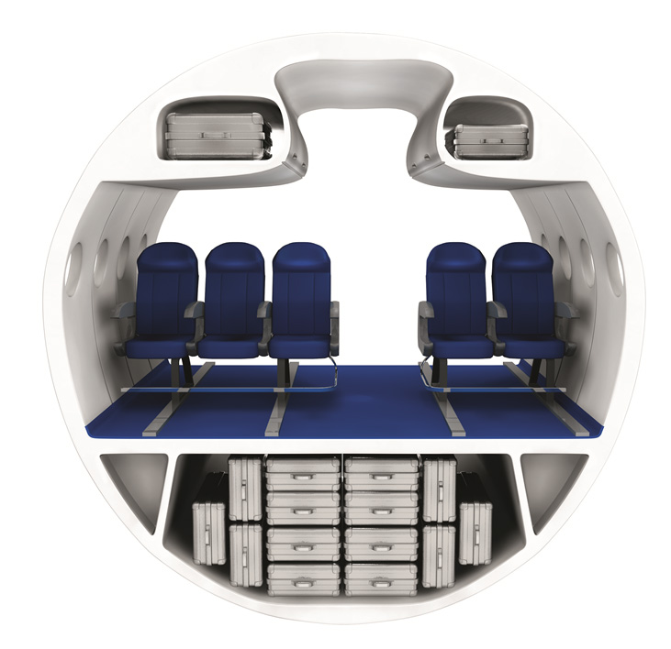
Cabin Cross Section
Cross section square
With bins 5,834 m²
Without bins 5,183 m²
Seat volume
With bins 0,948 m³
Without bins 0,843 m³
Bin length
2 meters for the whole cabin length
3,24 m (127.4”)
0,207 m³
(320.8 in³)
0,139 m³
(215.4 in³)
462 mm (18.2”)
508 mm (20.0”)
2,12 m (83.5”)
25”
1,50 m (59.1”)
Bin volume comparison, m³
0”
3,0 m (117.9”)
CRJ900
E190
A318
B737
SSJ100

Slide 9
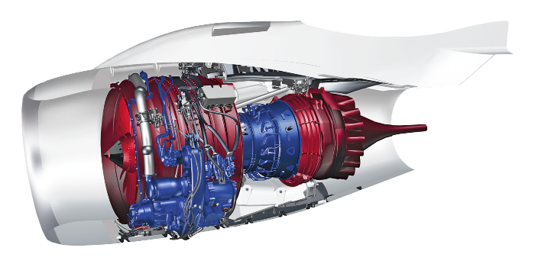
Propulsion System
SaM146
Core engine
Accessory drive
Control system
System integration
Flight testing
Fan
Low pressure compressor
Low pressure turbine
Assembly
Ground testing
PowerJet provides full range of services
Engineering, production, marketing & sales, customer support

Slide 10
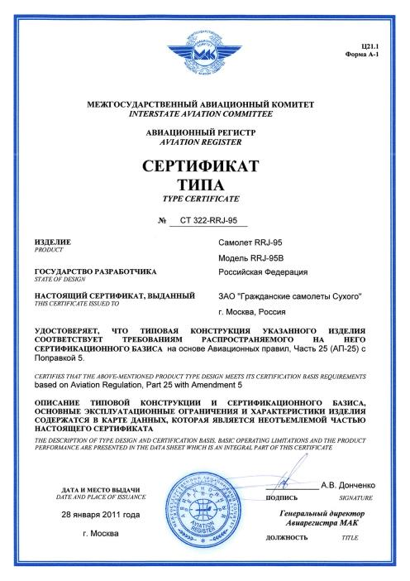
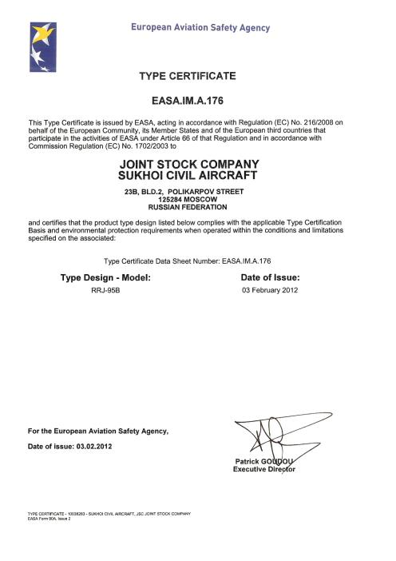
Certificates
IAC
January 2011
EASA February 2012

Slide 11
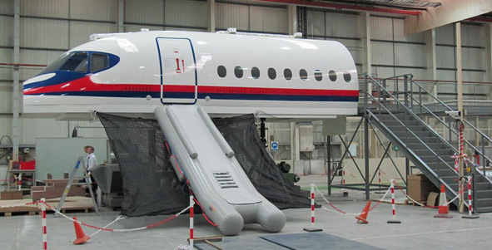
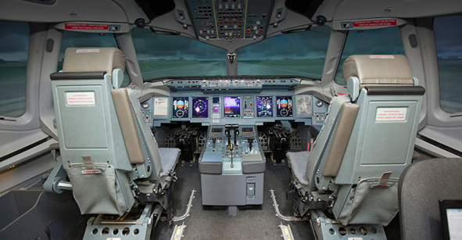
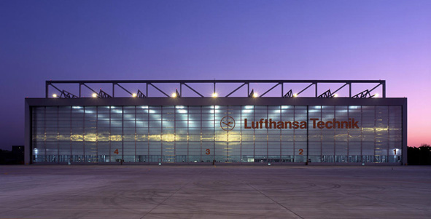
Support
Customer support center The unique point of contact for all customer requests from engineering to spares-related queries
Training centers Located in Moscow and Venice and certified as Flight Training Organization and Maintenance Training Organization
Warehouse management Lufthansa Technik Logistik warehouse in Frankfurt and Moscow warehouse serving customers from all around the world
MRO worldwide network Recognized partners, continuous development
The content of this presentation is provided as information only, is the property of Sukhoi Civil Aircraft Company
and shall not be copied or used without written consent from Sukhoi Civil Aircraft Company.

Slide 12
Support Plan
SuperCare Plan
Flight-by-the-Hour Solution
Main components (landing gear, APU)
LRU off-wing maintenance
On-site lease stock
Basic Care
Super Care
Exchange pool access, guaranteed availability
Ground support equipment, tooling support
Engineering services
Modular structure
Fixed rates per flight hour
Competitive prices
Individual approach

Slide 13
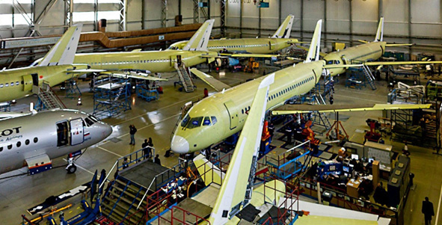
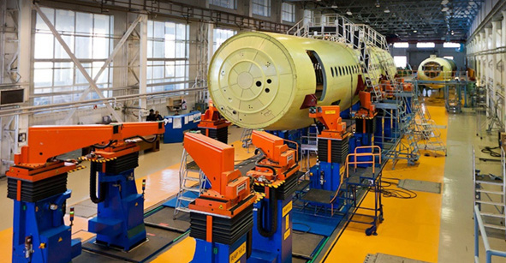
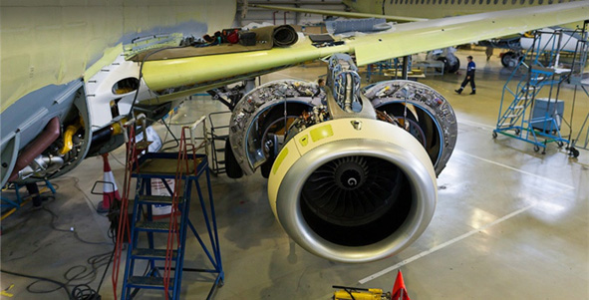
Ramp Production
Production plan
The content of this presentation is provided as information only, is the property of Sukhoi Civil Aircraft Company
and shall not be copied or used without written consent from Sukhoi Civil Aircraft Company.

Slide 14
Firm Orders
Aeroflot
Yakutia
Armavia
VEB-Leasing (UTair)
Lao Central
Kartika
Sky Aviation
Gazpromavia
Pearl Aviation
Willis Lease
Interjet
Blue Panorama
Transaero
179
total

Slide 15
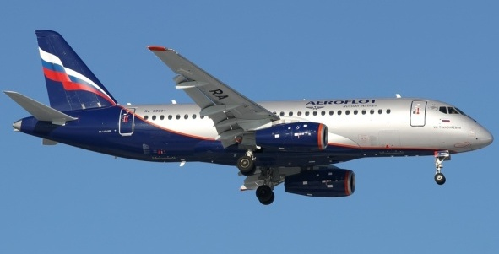
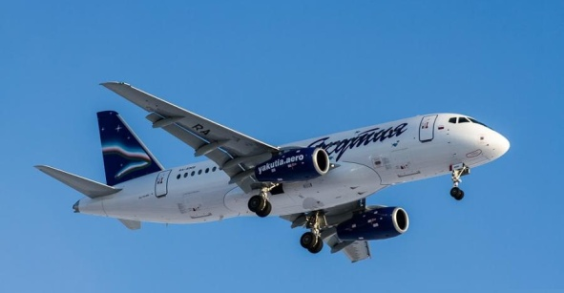
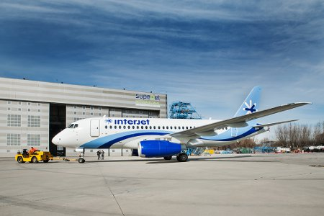
Operation and Delivery
1 Aircraft was delivered
to SJI for customization
The content of this presentation is provided as information only, is the property of Sukhoi Civil Aircraft Company
and shall not be copied or used without written consent from Sukhoi Civil Aircraft Company.

Slide 16
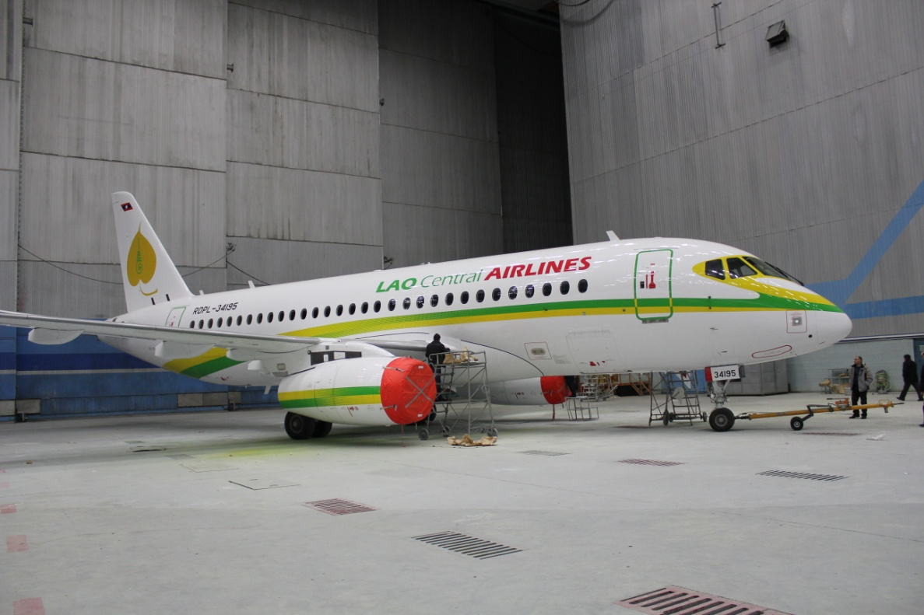
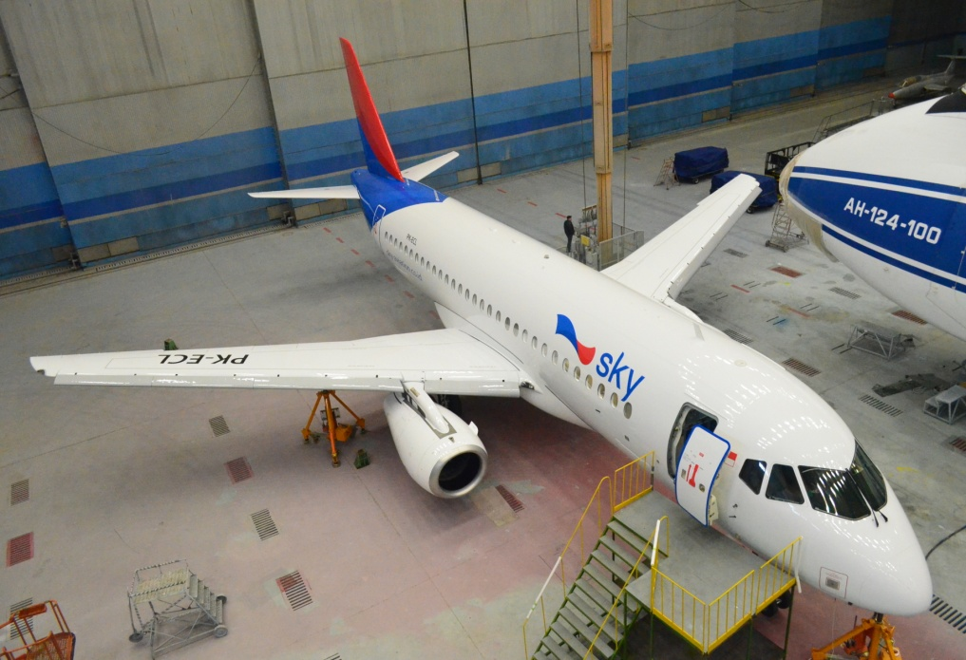
New Customers 2013
Lao Central Airlines
1 Aircraft was delivered
on February
Lao Central Airlines, February
PT. Sky Aviation
1 Aircraft was delivered
on February

Slide 17
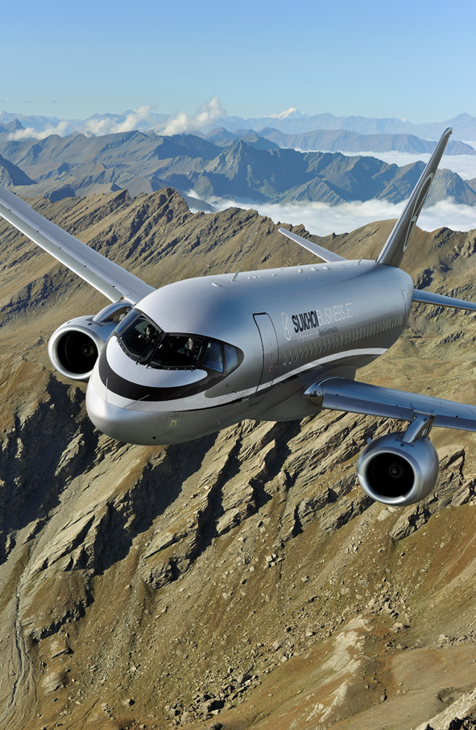
Program Development
2013 Sukhoi Superjet 100 Long Range IAC & EASA certification
2013 First deliveries of Sukhoi Superjet 100 Long Range
2015 Sukhoi Business Jet EASA certification
The content of this presentation is provided as information only, is the property of Sukhoi Civil Aircraft Company
and shall not be copied or used without written consent from Sukhoi Civil Aircraft Company.

Slide 18
Sukhoi Civil Aircraft
125284 Moscow, Polikarpov st. 23B
Phone :+7 (495) 727-19-88, 941-74-39
Fax: +7 (495) 946-05-60
Web: www.scac.ru
E-mail: sales@scac.ru
The content of this presentation is provided as information only, is the property of Sukhoi Civil Aircraft Company
and shall not be copied or used without written consent from Sukhoi Civil Aircraft Company.

