Slide 1
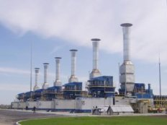
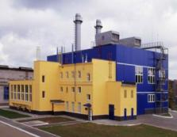
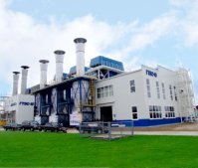
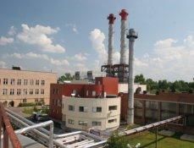
SATURN – GAS TURBINES POWER GENERATING AND GAS COMPRESSOR SETS
Notes:
1

Slide 2
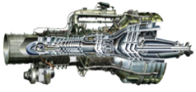
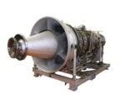
SATURN – GAS TURBINES PRODUCT LINE
η , %
25 MW
16 MW
GCS
10 MW
6.3 / 8 MW
4 MW
GCS
35-39%
38-44%
32-36%
25 MW
16 MW
12 MW
GS GTPP
2.5 MW
GS GTPP
10 MW
8 MW
6 MW
GTPP CCPP
Fuel:
associated gas, natural gas, synthesis gas;
✓ diesel fuel, kerosene.
28% >75%
35% >85%
>85% 42-46%
Ne, MW
GTPP – gas turbine power plant
CCPP - combined-cycle power plant
GCS – gas compressor set
GS - generator set
42% - electric efficiency
>85% - fuel utilization factor
2

Slide 3
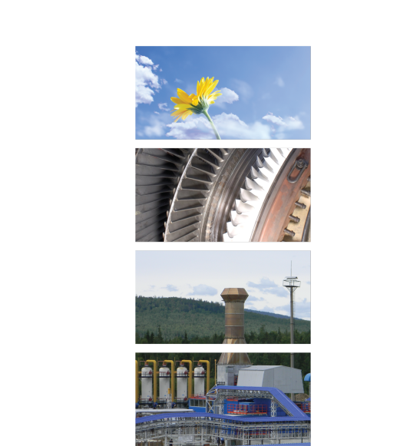
GAS COMPRESSOR SETS
4 – 25 MW
Gas compressor sets are designed to be used in underground gas storage stations (UGSS) and to transfer gas via pipelines.
The units are developed to meet the gas industry latest requirements.
Gas compressor sets provide high technical and economical performance values and allow to maintain state-of-the art level of gas transfer capabilities.
Gas compressor sets are equipped with remote control system with high protection level and meet all gas industry technical and operational requirements.
The units can be designed in two options: outdoor or indoor.
3
Notes:
3

Slide 4
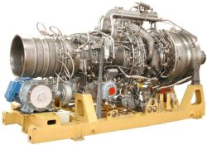
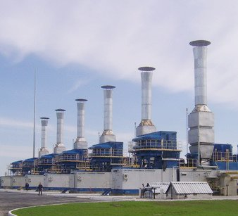
GPA-4RM GAS COMPRESSOR SET
GTD-4RM (NPO Saturn) - a drive for GPA-4RM
Rated power, MW | 4.1
Efficiency, % | 32.5
Overhaul life expectancy, hours | 25 000
Assigned life expectancy, hours | 100 000
Service life, years | 20
Delivery period (since contract conclusion), months | 9 - 12
Assembly period, months | 2 - 3
Fuel gas flow rate at nominal, kg/h | 935
4
Notes:
4

Slide 5
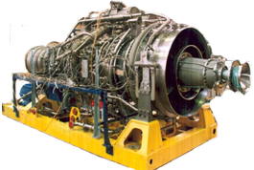
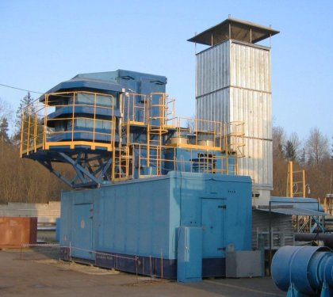
GPA-6,3/8RM GAS COMPRESSOR SET
GTD-6,3/8RM (NPO Saturn) – a drive for GPA-6,3/8RM
Rated power, MW | 6.3 | 6.3 / 8
Efficiency, % | 32 | 34.5
Overhaul life expectancy, hours | 25 000 | 25 000
Assigned life expectancy, hours | 100 000 | 100 000
Service life, years | 20 | 20
Delivery period (since contract conclusion), months | 9 - 12 | 9 - 12
Assembly period, months | 2 - 3 | 2 - 3
Fuel gas flow rate at nominal, kg/h | 1 435 | 1 672
5
Notes:
5

Slide 6
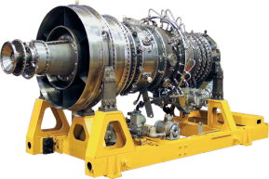
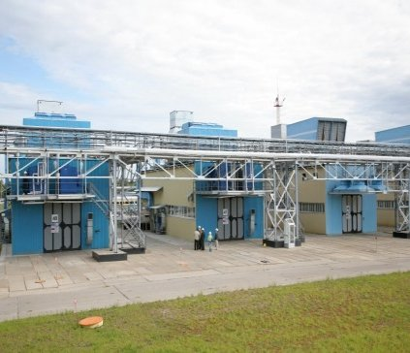
GPA-10RM GAS COMPRESSOR SET
GTD-10RM (NPO Saturn) - a drive for GPA-10RM
Rated power, MW | 10.2
Efficiency, % | 35.5
Overhaul life expectancy, hours | 25 000
Assigned life expectancy, hours | 100 000
Service life, years | 20
Delivery period (since contract conclusion), months | 9 - 12
Assembly period, months | 2 - 3
Fuel gas flow rate at nominal, kg/h | 2 045
6
Notes:
6

Slide 7
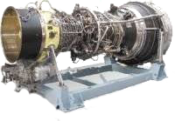
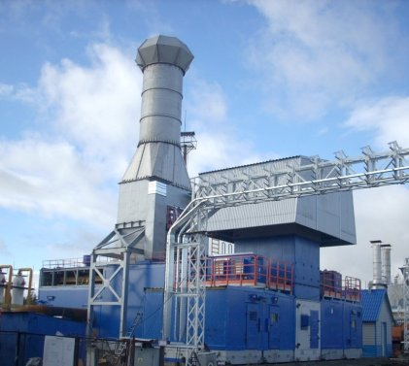
GPA-16 “ARLAN” GAS COMPRESSOR SET
PS-90GP2
AL-31ST
AL-31 ST or PS-90GP2 gas turbine engines may be used as a drive for GPA-16 “Arlan”
 | PS-90GP2 | AL-31ST
Rated power, MW | 16 | 16
Efficiency, % | 36.3 | 35.5
Overhaul life expectancy, hours | 25 000 | 25 000
Assigned life expectancy, hours | 100 000 | 75 000
Service life, years | 20 | 20
Delivery period (since contract conclusion), months | 9 – 12 | 9 - 12
Assembly period, months | 2 - 3 | 2 - 3
Fuel gas flow rate at nominal, kg/h | 3 175 | 3 305
7
Notes:
7

Slide 8
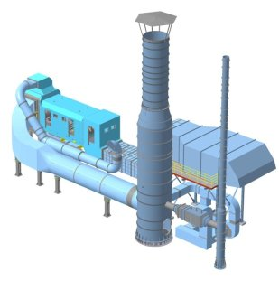
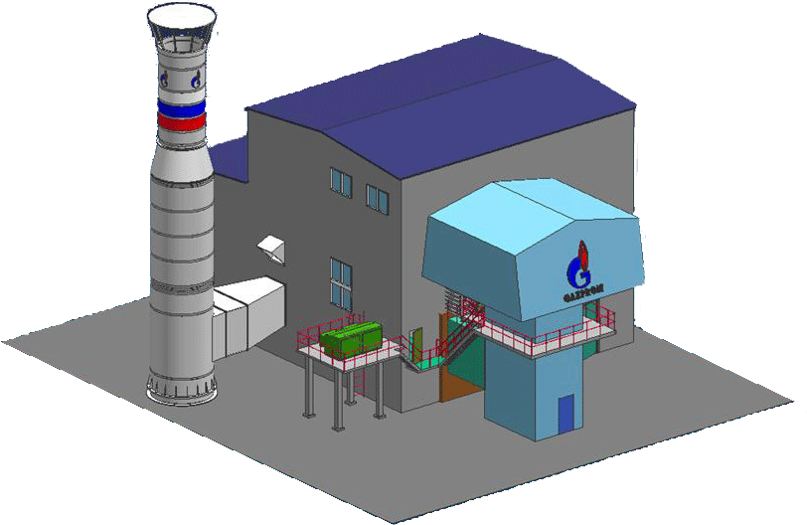
GTN-16R GAS COMPRESSOR SET
This type of gas compressor sets is used for replacement (reconstruction) of obsolete gas pumping equipment as well as for a construction of the new ones.
The following drives are used:
- PS-90GP2 (Aviadvigatel)
- AL-31ST (UMPO)
Reconstruction
New construction
8
Notes:
8

Slide 9
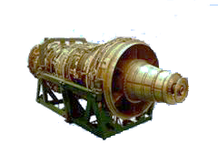
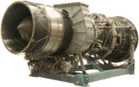
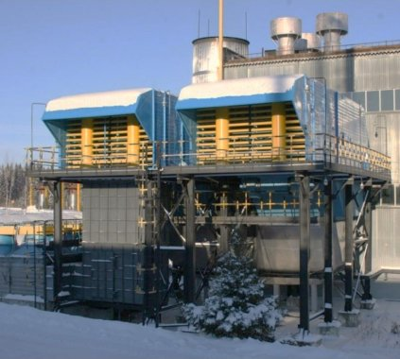
GPA-25 GAS COMPRESSOR SET
PS-90GP25
NK-36ST
PS-90GP25 or NK-36ST gas turbine engines may be used as a drive for GPA-25
 | PS-90GP25 | NK-36ST
Rated power, MW | 25 | 25
Efficiency, % | 37.9 | 34.5
Overhaul life expectancy, hours | 25 000 | 25 000
Assigned life expectancy, hours | 100 000 | 100 000
Service life, years | 20 | 20
Delivery period (since contract conclusion), months | 9 - 12 | 9 - 12
Assembly period, months | 2 - 3 | 2 - 3
Fuel gas flow rate at nominal, kg/h | 4 475 | 5 231
9
Notes:
9

Slide 10
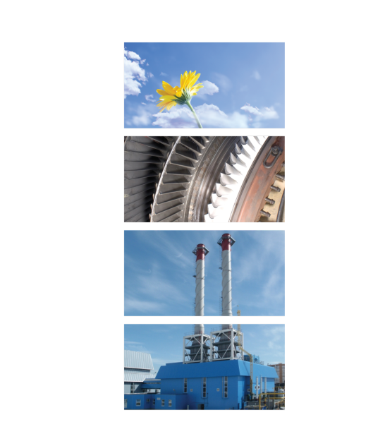
GENERATOR SETS AND
GAS TURBINE POWER PLANTS
2.5 – 25 MW
Reliable supply of electric power and heat to the factories and residential areas.
High fuel utilization factor reducing power consumption by enterprises by 2 – 2.5 times in comparison with prices from traditional power suppliers.
Small overall dimensions of the plant allow to save industrial space.
Effective environmental indexes (noise level <80 dB, emission <23ppm) allow to install the plant near the residential areas.
Possibility to run on various types of fuel, including: natural gas, associated oil gas, synthetic gas, diesel fuel.
10
Notes:
10

Slide 11
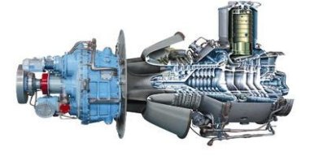
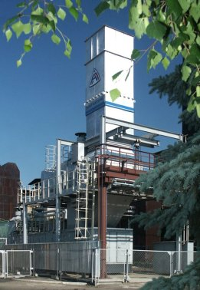
GTES-2,5 GAS TURBINE POWER PLANT
D049R (NPO Saturn) is a drive for GTES-2,5
Rated power, MW | 2.5
Voltage across turbine generator terminals, kV | 6.3 / 10.5
Efficiency, % | 28,5
Fuel utilization factor (cogeneration), % | 74.5
Overhaul life expectancy, hours | 20 000
Assigned life expectancy, hours | 120 000
Service life, years | 20
Delivery period (since contract conclusion), months | 11
Assembly period, months | 1
Fuel gas flow rate at nominal, kg/h | 680
GT upstream fuel gas pressure, MPa | 21 – 25
Heat power, Gcal/h | 3.87
Plant outline dimensions, m | 12.84 х 3.2 х 2.85
11
Notes:
11

Slide 12
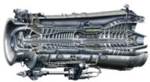
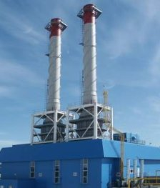
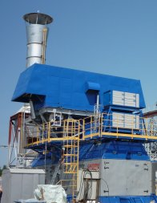
GTA-6 AND GTA-8 GENERATOR SETS
D30KU/KP (NPO Saturn) is a drive for GTA -6/8
 | GTA-6 | GTA-8
Rated power, MW | 6.0 | 8.0
Voltage across turbine generator terminals, kV | 6.3 / 10.5 | 6.3 / 10.5
Efficiency, % | 25.0 | 25.8
Fuel utilization factor (cogeneration), % | 85.65 | 92.64
Overhaul life expectancy, hours | 30 000 | 25 000
Assigned life expectancy, hours | 120 000 | 100 000
Service life, years | 20 | 20
Delivery period (since contract conclusion), months | 9 - 12 | 9 - 12
Assembly period, months | 2 | 2
Fuel gas flow rate at nominal, kg/h | 1 830 | 2 382
Heat power, Gcal/h | 13,3 | 17,1
Plant outline dimensions, m | 14.6 х 3.6 х 3.8
Indoor option
Outdoor option
12
Notes:
12

Slide 13
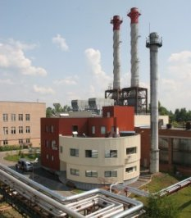
GTA-6,3RM AND GTA-8RM GENERATOR SETS
GTD-6,3/8RM (NPO Saturn) is a drive for GTA - 6,3RM
 | GTD-6,3RM | GTD-6,3/8RM
Rated power, MW | 6.3 | 8.0
Voltage across turbine generator terminals, kV | 6.3 / 10.5 | 6.3 / 10.5
Efficiency, % | 32.0 | 33.0
Fuel utilization factor (cogeneration), % | 75.6 | 72.0
Overhaul life expectancy, hours | 25 000 | 25 000
Assigned life expectancy, hours | 100 000 | 100 000
Service life, years | 20 | 20
Delivery period (since contract conclusion), months | 9 – 12 | 9 - 12
Assembly period, months | 2 – 3 | 2 - 3
Fuel gas flow rate at nominal, kg/h | 1 419 | 1 730
Heat power, Gcal/h | 7.5 | 12.68
Plant outline dimensions, m | 14.6 х 3.6 х 3.8
Indoor option
Outdoor option
13
Notes:
13

Slide 14
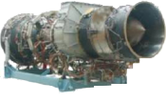
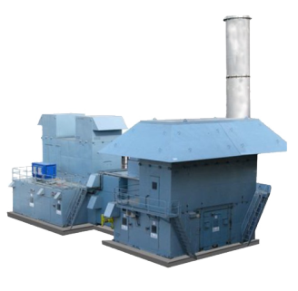
GTA 12 GENERATOR SET
PS-90GP
GTE-12S
PS-90GP and GTE-12S are the drives for GTA-12
 | PS-90GP | GTE-12S
Rated power, MW | 12 | 12
Voltage across turbine generator terminals, kV | 6.3 / 10.5 | 6.3 / 10.5
Efficiency, % | 33 | 30,5
Fuel utilization factor (cogeneration), % | 83 | 80
Overhaul life expectancy, hours | 30 000 | 25 000
Assigned life expectancy, hours | 120 000 | 100 000
Service life, years | 20 | 18
Delivery period (since contract conclusion), months | 9 – 12 | 9 - 12
Assembly period, months | 2 – 3 | 2 - 3
Fuel gas flow rate at nominal, kg/h | 2 903 | 2 980
Heat power, Gcal/h | 16.6 | 21.51
Plant outline dimensions, m | 14.84 х 3.6 х 3.8
14
Notes:
14

Slide 15
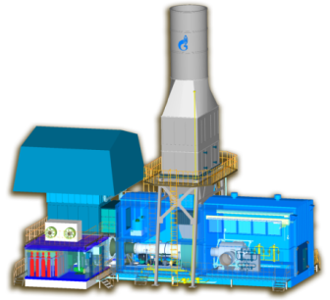
GTA 16 GENERATOR SET
PS-90EU16
AL-31ST
PS-90EU16 and AL-31ST are the drives for GTA-16
 | PS-90EU16 | AL-31ST
Rated power, MW | 16.3 | 16.0
Voltage across turbine generator terminals, kV | 6.3 / 10.5 | 6.3 / 10.5
Efficiency, % | 35.5 | 37
Fuel utilization factor (cogeneration), % | 85 | 85
Overhaul life expectancy, hours | 25 000 | 25 000
Assigned life expectancy, hours | 100 000 | 100 000
Service life, years | 20 | 20
Delivery period (since contract conclusion), months | 9 – 12 | 9 - 12
Assembly period, months | 2 – 3 | 2 - 3
Fuel gas flow rate at nominal, kg/h | 4 746 | 3 305
Heat power, Gcal/h | 20.4 | 23.5
Plant outline dimensions, m | 20.3 х 15.2 х 21
15
Notes:
15

Slide 16
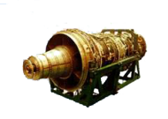
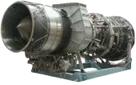
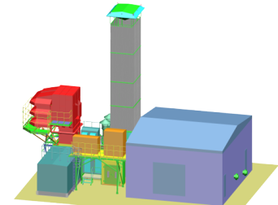
GTA-25 GENERATOR SET
PS-90GP25
NK-37ST
PS-90GP25 and NK-37ST are the drives for GTA-25
 | PS-90GP25 | NK-37ST
Rated power, MW | 22.5 | 25.0
Voltage across turbine generator terminals, kV | 6.3 / 10.5 | 6.3 / 10.5
Efficiency, % | 36.2 | 34.4
Fuel utilization factor (cogeneration), % | 86 | 86
Overhaul life expectancy, hours | 30 000 | 25 000
Assigned life expectancy, hours | 120 000 | 100 000
Service life, years | 21 | 20
Delivery period (since contract conclusion), months | 9 – 12 | 9 - 12
Assembly period, months | 2 – 3 | 2 - 3
Fuel gas flow rate at nominal, kg/h | 4 475 | 4 994
Heat power, Gcal/h | 26.5 | 31.7
Plant outline dimensions, m | 28 х 22.9 х 27.7
16
Notes:
16

Slide 17
GAS TURBINE EQUIPMENT
IN POWER ENGINEERING
Power supply for oil and gas fields, power consuming enterprises and facilities detached from centralized power supply.
Reconstruction of obsolete equipment of boiler houses, heat power plants and state district power plants.
Installation of new gas turbine equipment enable to increase the fuel utilization factor for more than 80%, thus saving fuel and increasing the quality of power supply.
Combined cycle power plants provide heat and electric power to enterprises, utility companies and companies of oil and gas industry.
The fuel utilization factor in combined cycle increases by 1.5 times.
17
Notes:
17

Slide 18
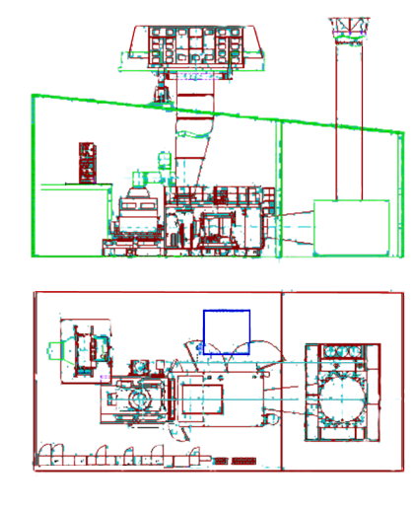
GTES-6 GAS TURBINE HEAT POWER PLANT
 | MAIN EQUIPMENT | Q-ty, pcs.
1 | Gas turbine GTA-6RM | 1
2 | Generator | 1
3 | Air intake and filter unit | 1
4 | Gas duct | 1
5 | WHRU Е-50/3,9-440 | 1
6 | Fire extinguishing system | 1
7 | Auxiliary switch and control gear | 1
8 | Switch and control gear | 1
9 | Control panels | 1
WHRU
18
Notes:
18

Slide 19
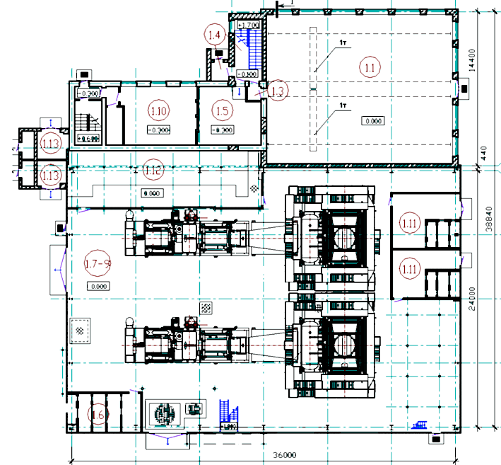
GTES-12 GAS TURBINE HEAT POWER PLANT
 | MAIN EQUIPMENT | Q-ty, pcs.
1 | Gas turbine GTA-6RM | 2
2 | Generator | 2
3 | Air intake and filter unit | 2
4 | Gas duct | 2
5 | WHRU Е-50/3,9-440 | 2
6 | Fire extinguishing system | 1
7 | Auxiliary switch and control gear | 2
8 | Switch and control gear | 2
9 | Control panels | 2
19
Notes:
19

Slide 20
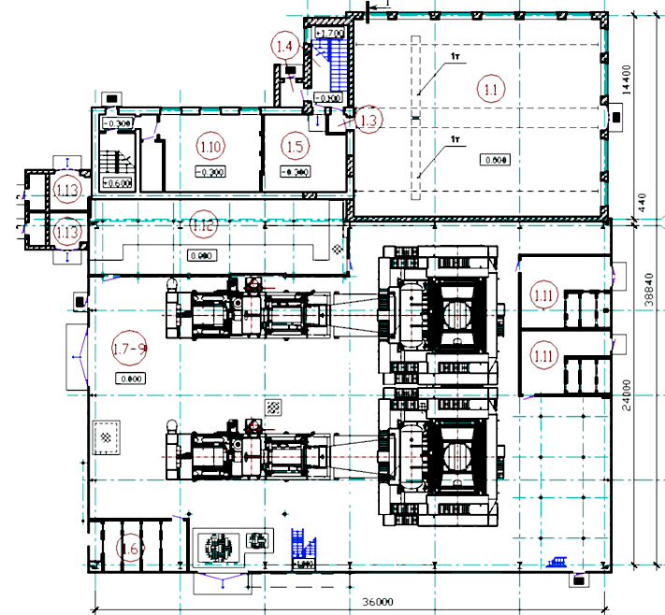
GTES-16 GAS TURBINE HEAT POWER PLANT
 | MAIN EQUIPMENT | Q-ty, pcs.
1 | Gas turbine GTA-8RM | 2
2 | Generator | 2
3 | Air intake and filter unit | 2
4 | Gas duct | 2
5 | WHRU E-50/3,9-440 | 2
6 | Fire extinguishing system | 1
7 | Auxiliary switch and control gear | 2
8 | Switch and control gear | 2
9 | Control panels | 2
20
Notes:
20

Slide 21
 | MAIN EQUIPMENT | Q-ty, pcs.
1 | Gas turbine GTA-8RM | 2
2 | Generator | 2
3 | Air intake and filter unit | 2
4 | Gas duct | 2
5 | HRSG KGT-10/4,0-440 | 2
6 | Fire extinguishing system | 2
7 | Steam turbine T-6-4,0/0,18 | 1
8 | Steam turbine generator | 1
9 | Condenser | 1
10 | Auxiliary switch and control gear | 2
11 | Switch and control gear | 1
12 | Control panels | 2
13 | Deaerator | 2
4000
19105
4600
11613
0
0
0
1
-
3
,
С
750
.
С
у
.
0
у
0
6
4
4600
0
-
0
3
,
0
750
2
1
0
0
0
0
0
0
6
2
В
В
0
4
к
к
4
5
0
,
,
6
0
0
3
0
-
1
0
Н
4
С
У
4
У
Р
Р
К
4
,
4600
200
51000
9000
21
Notes:
21

Slide 22
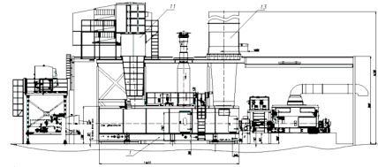
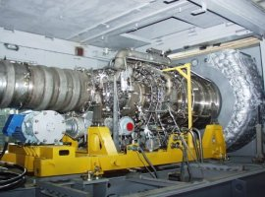
PGU-28 COMBINED CYCLE POWER PLANT
 | MAIN EQUIPMENT | Q-ty, pcs.
1 | Gas turbine GTA-10RM | 2
2 | Generator | 2
3 | Air intake and filter unit | 2
4 | Gas duct | 2
5 | HRSG KGT-10/4,0-440 | 2
6 | Fire extinguishing system | 2
7 | Steam turbine T-8-4,0/0,18 | 1
8 | Steam turbine generator | 1
9 | Condenser | 1
10 | Auxiliary switch and control gear | 2
11 | Switch and control gear | 1
12 | Control panels | 2
13 | Deaerator | 2
GTD-10R/RM drive (NPO Saturn)
22
Notes:
22

Slide 23
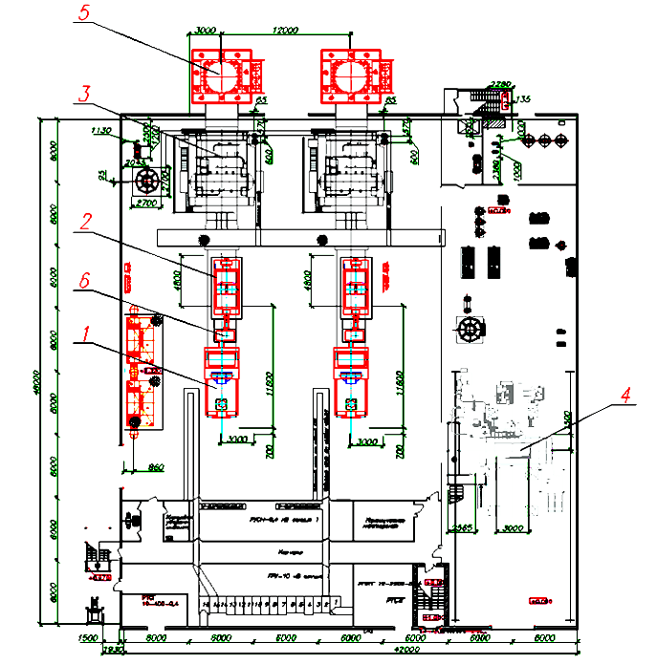
PGU-32 COMBINED CYCLE POWER PLANT
 | MAIN EQUIPMENT | Q-ty, pcs.
1 | Gas turbine unit GTU-12P | 2
2 | Generator TS-12-2 RUHL3 | 2
3 | HRSG KGT-17/4.0-440 | 2
4 | Steam turbine T-8.5/10.2-3.4/0.18 with GTG-8-RUHL3 generator set | 1
5 | Exhaust duct | 2
6 | Gearbox | 2
23
Notes:
23

Slide 24
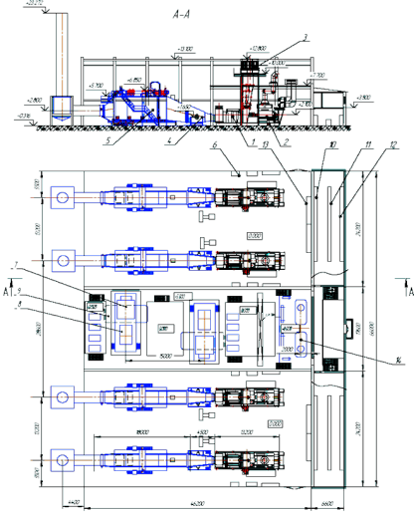
PGU-52 COMBINED CYCLE POWER PLANT
 | MAIN EQUIPMENT | Q-ty, pcs.
1 | Gas turbine GTA-8RM | 4
2 | Generator | 4
3 | Air intake and filter unit | 4
4 | Gas duct | 4
5 | HRSG KGT-20/4,0-440 | 4
6 | Fire extinguishing system | 4
7 | Steam turbine T-10-4,0/0,18 | 2
8 | Steam turbine generator | 2
9 | Condenser | 1
10 | Switch gear | 2
11 | Auxiliary switch and control gear | 2
12 | Switch and control gear | 1
13 | Control panels | 2
14 | Deaerator | 2
24
Notes:
24

