Slide 1
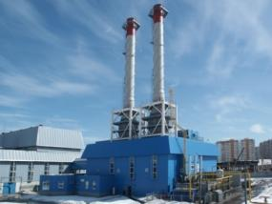
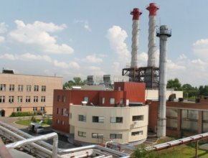
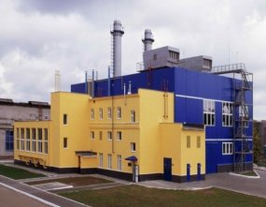
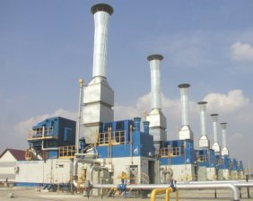
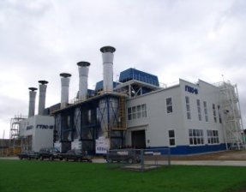
Rybinsk, Russia
www.saturn-gt.ru

Slide 2
JSC SATURN – GAS TURBINES IN ROSTEC STRUCTURE
State Corporation
Rosteс
United Industrial Corporation
OBORONPROM
Over 400 companies of mechanical engineering industry
United
Engine
Corporation
Russian Helicopters
Klimov
Chernyshev Machine-Building Enterprise
NPO Saturn
Aviadvigatel
STAR
UMPO
Kuznetsov
Perm Engine Company
Manufacturing of gas turbine generator sets and gas compressor sets, turn-key construction of power generating plants
Gas turbine drive manufacturers
2

Slide 3
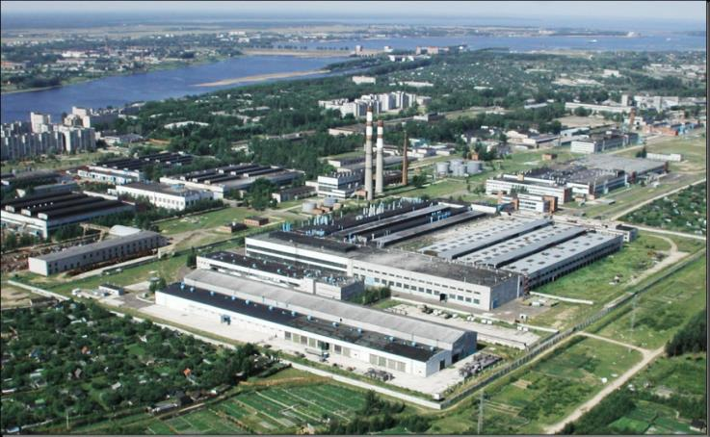
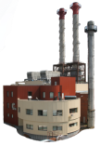
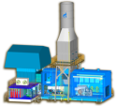
SATURN – GAS TURBINES TODAY
Saturn–Gas Turbines is the United Engines Corporation (UEC) leading company for manufacturing of power generating and gas compressor sets as well as for the power generating plants turn-key construction.
MISSION: Based on best practices of effective conversion of natural resources into energy and using professionalism and talents of our employees we manufacture state-of-the-art reliable equipment for sustainable development and improvement of social opportunities and life quality
Scope of works
Integrated
Project
Approach
Service
Investment
support
Turnkey projects
Design and development
Construction Installation
Commissioning
Equipment
design
Equipment
manufacturing
Industrial
facilities
design
The company manufactures as follows:
Gas turbine generator sets (GS)
Gas turbine power plants (GTPP)
Combined-cycle power plants (CCPP)
Gas compressor sets (GCS)
Equipment for heat power plants
Equipment for nuclear power plants
Sets
delivery
Construction and
installation
activities
Drives
delivery
Commissioning and start-up
Project
GT
GS
GCS
S
New objects construction /
Reconstruction
Service
Project
monitoring
3

Slide 4
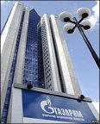
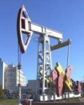
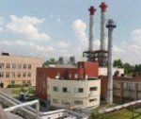
MAIN CUSTOMERS
Gazprom, JSC
Supply of power generating and gas compressor equipment for construction of new and reconstruction of old plants
Worldwide
market
Supplies of
power generating, gas compressor sets and
waste heat recovery
generators
Oil & Gas companies
Power supply to the oil and gas fields, recycling of associated oil gas
Regional power generation and power generating companies
Reconstruction of boiler houses,
heat power plants, state power plants, power supply
for industrial facilities
State corporations
Increase of power efficiency of such companies as Rostec, United Aircraft Corporation, Russian Railways, InterRAO.
4

Slide 5
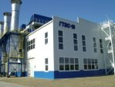
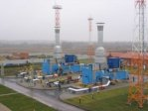
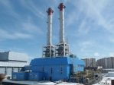
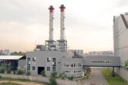
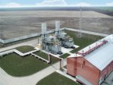
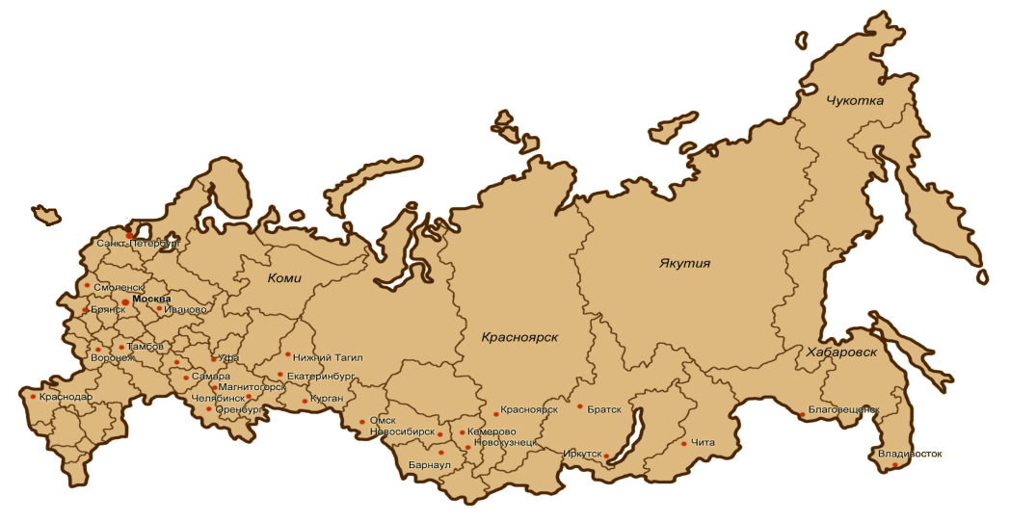
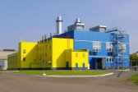
RUSSIA: COMPLETED AND LONG-TERM PROJECTS
Chukotka
Saint Petersburg
Komi
Yakutia
Smolensk
Moscow
Bryansk
Ivanovo
Krasnoyarsk
Tambov
Ufa
Nizhni Tagil
Khabarovsk
Voronezh
Samara
Ekaterinburg
Krasnodar
Magnitogorsk
Kurgan
Chelyabinsk
Krasnoyarsk
Bratsk
Blagoveschensk
Orenburg
Omsk
Novosibirsk
Kemerovo
Chita
Novokuznetsk
Irkutsk
- completed projects
- long-term projects
Barnaul
The UEC companies have commissioned power generating and gas compressor sets with total aggregate rated power of more than 7,000 MW. UEC has 70% share of supplies to the Russian market.
5

Slide 6
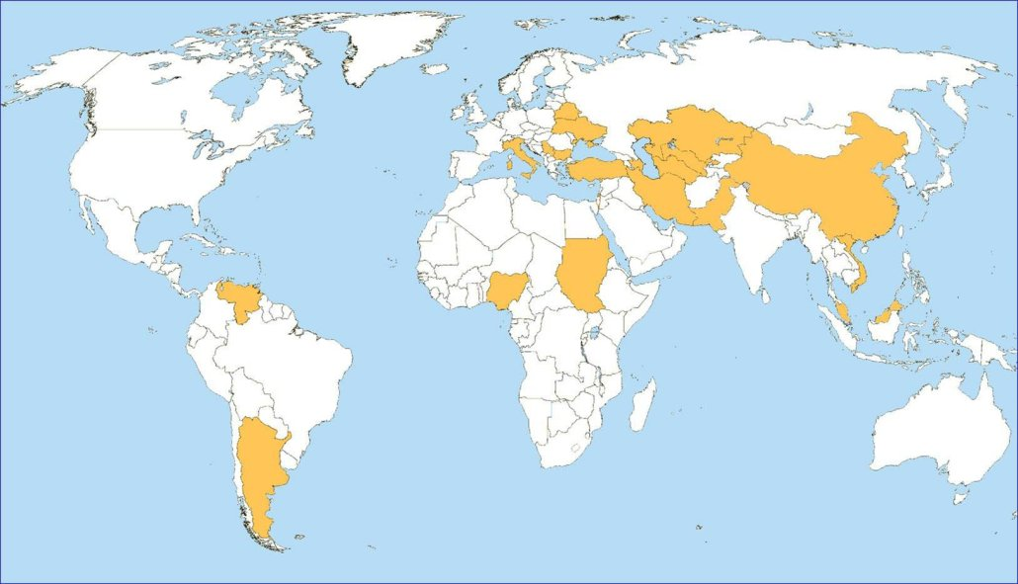
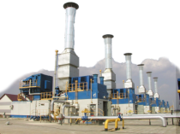
WORLDWIDE COMPLETED AND LONG-TERM PROJECTS
Belorussia
Kazakhstan
Serbia
Ukraine
Italy
Bulgaria
Uzbekistan
Azerbaijan
China
Turkey
Turkmenistan
Pakistan
Iran
Vietnam
Sudan
Nigeria
Venezuela
Malaysia
Argentina
- completed projects
- long-term projects
United Engine Corporation share on the world market is 4%. UEC strategy is to increase this number up to 13.9% by the year of 2019.
6

Slide 7
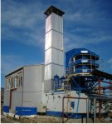
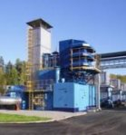
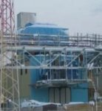
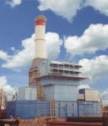
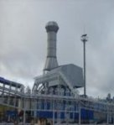
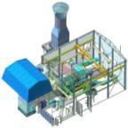
GAS COMPRESSOR SETS
GPA-4RM
Rated power
4 MW
GPA-6,3RM
GPA-6,3/8RM
Rated power
6.3 & 8 MW
GPA –10
Rated power
10 MW
GPA –12
Rated power
12 MW
GPA –16 «Arlan»
Rated power
16 MW
GPA –25
Rated power
25 MW
32.5 %
32.0 / 34.5%
35.5 %
35.5 %
36.3 / 35.5%
37.9 / 34.5%
Efficiency
GTD-4RM
GTD-6,3 / 6,3/8RM
GTD-10RM
GTU-12P
AL-31ST
PS-90GP25
Engine type
Gas compressor sets rated at 4 MW to 25 MW were developed by
Saturn – Gas Turbines and launched into serial production.
PS-90GP2
NK-36ST
7

Slide 8
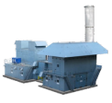
POWER GENERATING SETS AND POWER PLANTS
GTES-2,5
2.5 MW
GTA-6 / 8 / 10
6 / 8 / 10 MW
GTA –12
12 MW
GTA –16
16 MW
GTA –25
25 MW
28.5 %
25.0 – 35.5%
30.5 / 33.4%
36.3 %
37.9 / 34.4%
Efficiency
DO49R
GTD-6/8RM
PS-90P
AL-31ST
PS-90GP25
Engine type
GTD-10RM
GТD-12S
PS-90EU16
NК-37SТ
Saturn – Gas Turbines manufactures gas turbine generating sets and power plants rated at 2.5 MW to 77 MW. Works are under way both for expansion of products power range and for creation of new types of units within the existing range.
8

Slide 9
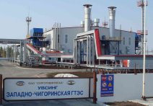
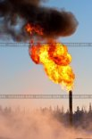
RECYCLING OF ASSOCIATED OIL GAS
PROGRAMMES IMPLEMENTATION
In the framework of cooperation with oil companies (i.e. OC Rosneft, TNK-BP, Surgutneftegaz, Lukoil, Slavneft, etc.) Saturn - Gas Turbines is involved in oil and gas complex programmes implementation to comply with the requirements of United Nations Framework Convention on Climate Change (UNFCCC) and Kyoto Protocol, article 6 focused on recycling of associated oil gas and implementation of development programmes covering power generating capacity of oil companies.
9

Slide 10
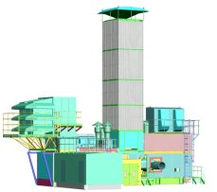
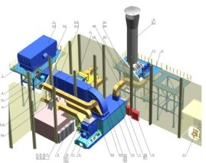
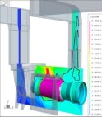
ENGINEERING PROCESS
Saturn – Gas Turbines has a specialized design and development bureau carrying out complete cycle of development of documents required for manufacturing of products supplied by the company.
DESIGN BUREAU ACTIVITIES: 1. Development of design documents for manufacturing, assembling and installation of power generating and gas reciprocating sets. 2. Engineering supervision of manufacturing process. 3. Engineering supervision of installation and commissioning at site. 4. Development of documents for overhaul of power generating and gas compressor sets. 5. Strength, hydraulic and environmental calculations for GCS and GS design solutions.
The company implements end-to-end computer-aided design approach that is directly integrated in the process and allows to make corrections of any complexity to design automatically. State-of-the-art software products are used for design engineering and calculation purposes, such as AutoCAD, Ansys, Unigrafics, CFX-TASCflow.
Design Bureau structure
Design and Development Bureau of Saturn – Gas Turbines in Rybinsk Number of employees - 228
“Industrial gas turbines” Design Bureau in Moscow Number of employees - 37
Subsidiary Design Bureau in Sumy (Ukraine) Number of employees - 16
10

Slide 11
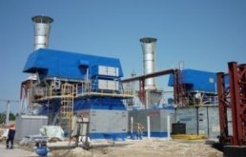
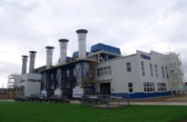
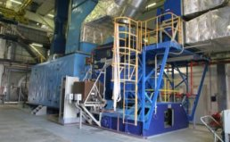
POWER PLANTS TURNKEY CONSTRUCTION
Scope of works carried out by
Saturn-Gas Turbines for
turnkey construction projects:
Saturn-Gas Turbines exercises stand-alone power plants turnkey construction projects from feasibility study (FS) and project design to project start-up and aftersales servicing with no subcontractors.
Feasibility study
Project design
Equipment manufacturing
Construction
Installation and commissioning
Start-up
Aftersales service
11

Slide 12
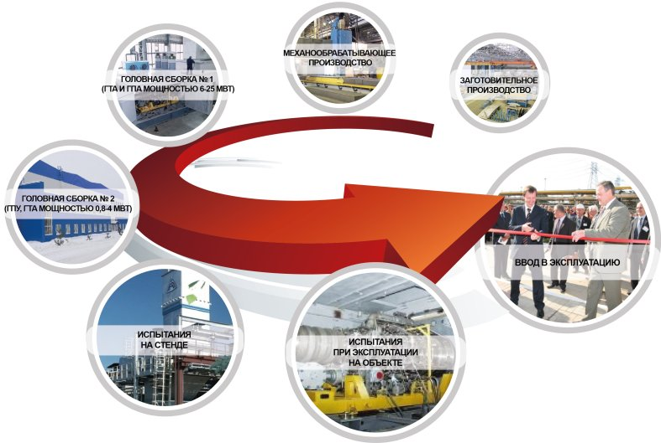
FULL PRODUCTION CYCLE
Saturn-Gas Turbines production cycle is focused on manufacturing of power generating and gas compressor sets through a complete cycle including blanking and machining.
MECHANICAL MACHINING
FINAL ASSEMBLY LINE № 1
(6-25 MW GS AND GCS)
BLANKING
FINAL ASSEMBLY LINE № 2
(0,8-4 MW GRS AND GS)
START-UP
TEST IN THE TEST CELL
PERFORMANCE TESTING ON SITE
12

Slide 13
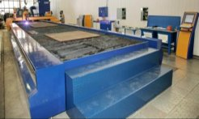
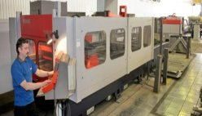
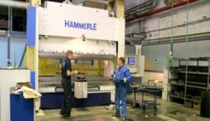
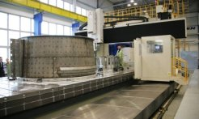
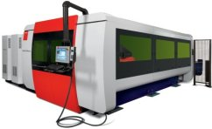
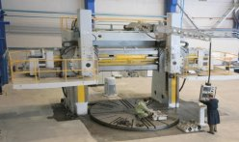
BLANKING AND MACHINING
PLASMA CUTTING MACHINE MG 12001.25 PkG
LASER CUTTING AREA BASED ON BYSTRONIC MACHINERY
SHEET BENDING PRESS HAMMERLE
Machining range:
Plasma cutting – carbon and
stainless steel - up to 80 mm,
Gas cutting - up to 200 mm.
Table dimensions 12,000 х 2,500 mm
Machining range:
Aluminium alloys - up to 8 mm,
Stainless steel - up to 10 mm,
Construction steel – up to 20 mm.
Max. processed part dimensions 1,480 х 2,980
Machining range:
Length up to 3,000 mm, thickness up to 10 mm
Pressing force - 200 tons
RIGID-BED BRIDGE-TYPE MILLING AND DRILLING MACHINE
MG 48/140
LASER CUTTING MACHINE WITH NC BYSPRINT FIBER 3015
VERTICAL BORING AND TURNING MACHINE MODEL 1540
Fibre optic laser cutting speed is higher than the one of CO2 laser:
1 mm thickness x 2.5 times higher;
2 mm thickness x 1.8 times higher;
3 mm thickness x 1.3 times higher;
4 mm thickness x 1.1 times higher.
Processing capability
L = 14,000 mm; B = 4,000 mm; H = 2,200 mm;
p = 80,000 kg
Processing accuracy 0.03 mm
Processing capability
Ǿ = 4,000 mm;
H = 2,200 mm;
p = 63,000 kg
13

Slide 14
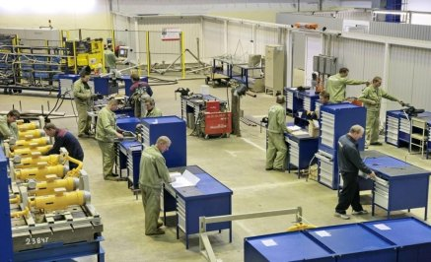
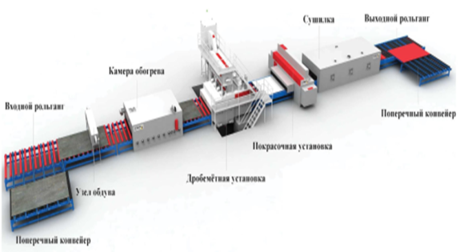
SPECIALIZED PRODUCTION
PIPE BENDING MACHINES:
Pipe diameter, mm:
min 6
max 102
Pipe length, mm: 4,000
Bending radius, mm:
min 50
max 350
Max. pipe wall thickness: 2
SHOT BLASTING AND PAINTING LINE ROSLER
Dryer
Outlet roller conveyor
The line includes sequential process operations in automatic mode:
metal plates and profiles shot blasting;
applying holding primer;
drying.
Processed part dimensions: -up to 12,000 х 2,000 х 500 mm.
-Weight: up to 1,200 kg.
The line eliminates interoperation corrosion and speeds the treatment up to 12 times faster.
Gas-fired pre-heater unit
Inlet roller conveyor
Cross transfer lines
Paint booth
Blasting chamber
Shot blasting machine
Cross transfer lines
14

Slide 15
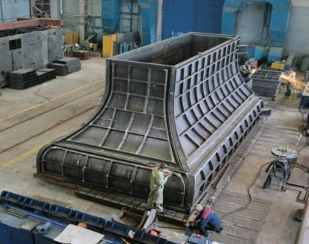
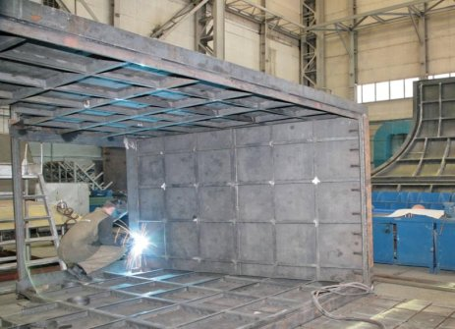
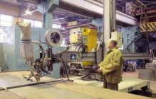
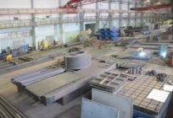
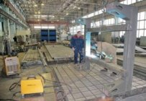
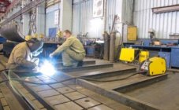
ASSEMBLING:
BULKY ASSEMBLY UNITS (GCS and GS)
Assembling and welding of large subassemblies and assembly units with dimensions up to 3,000 х 15,000 х 3,000 mm and weight up to 30 tons.
Railway lines allow to transport products by railway vehicles.
15

Slide 16
ASSEMBLING: FINAL ASSEMBLY
ASSEMBLY LINES THROUGHPUT CAPABILITY IS 150 SETS A YEAR
16

Slide 17
SERVICE SUPPORT
Saturn-Gas Turbines service centre provides full scope of services for installation, commissioning and start-up of gas turbine power plants and gas compressor sets at Customer site. It provides maintenance servicing and after-sales support for GT and GCS and their systems.
The activity is carried out in compliance with License No. AD 808941 dtd. 05.02.2007, registration number GS-1-76-02-27-0-7610070114-005085-1 issued by Federal Agency for Construction, Housing and Utilities.
High technical level and qualification of service centre personnel allows to do the following activities efficiently and qualitatively:
- maintenance servicing and after-sales support;
- operation engineering support;
- scheduled maintenance;
- equipment repair of any kind;
- spare parts supply;
- technical evaluation, inspection and diagnostics;
- implementation of engineering modifications intended to power plants operation improvement;
- customer personnel training.
Saturn-Gas Turbines service centres are located in the following cities: Moscow, Krasnoturinsk, Surgut. Taking into account the fact that Saturn-Gas Turbines supplies its equipment to more and more locations, in the nearest future service centres are planned to be opened in Kaliningrad, Stavropol, Yugorsk, Tomsk and Khabarovsk.
17

Slide 18
AUTOMATIC MONITORING SYSTEM OPERATION
Satellite
-Company runs the Customer on-line monitoring support Centre.
-When large-volume regional orders are in place, Saturn – Gas Turbines organizes local service centre.
Unlimited distance
Krasnoznamensk
Izborsk
Support Centre Engineer
Vologda
CS Novosidorinskaya
Naryan-Mar
Dorogobuzhskaya CHP
CS Nyuksenitsa
CS Yubileinaya
Video
conference
Moscow UGS
Rybinsk
CS Novoprivodninskaya
CS Kharyaga
Internet Server
Kaluga
Tutaev
CCPP-CHP-52
Usinsk GPP
Harvuta
Gavrilov-Yam
Nizhne-Shapkinskoe
Ivanovo
Video
conference
Pelymskaya
Yurkharovo
Kasimov
Kamennoe field
Pestsovoe
Operational personnel
Monitoring unit parameters
via Internet
E-mail
Automated
system of
handling orders
Mikhailovka
Yavasskaya
Data base server
of customers’ calls,
and defects
CS Nizhneturinskaya
Surgut
Salsk
CS Lyalinskaya
OC Rosneft
Igolsko-Talovoe
Yuzhno-Sakhalinskaya CHPP
Stavropol
Tailakovskoe field
Dvurechenskoe field
Company departments
Omsk
TASKS
Increase in rapidness and efficiency of service and repair works on equipment.
Development of centralized service and repair system for gas compressor and power generating equipment.
Creation of long-term mutually beneficial cooperation with customers.
Creation of replacement stock for engines and constant level stock of spare parts.
:
18

Slide 19
QUALITY POLICY
Delivery of high quality products meets both market requirements and customer needs
In 2010 Saturn – Gas Turbines received Quality Management System certificates which comply with ISO 9001:2008 and Russian quality standard GOST.R ISO 9011-2008 requirements.
SGT is a prize winner of Yaroslavl “Top Quality Assurance” regional contest.
2009 - 2011 - for three years in a row SGT has been awarded “The best company of Yaroslavl region” diploma.
In 2012 SGT was successfully certified for GAZPROM STO 9001-2006 requirements.
In April, 2012 for significant results in quality achievements SGT was awarded with Government of Russian Federation diploma.
On Dec,06 2012, SGT was declared a winner of the Central and Eastern European Countries 8th International Quality Competition.
19

